Slide 1

Subject: Maths-II
Module Number: 2
Sub Module: 1.1
Module Name -Correlation and Regression Analysis

Slide 2
Correlation and Regression Analysis
Correlation Analysis:
Correlation analysis is a statistical technique used to measure the strength and direction of the relationship between two variables.
OR
Correlation analysis deals with association between two or more variables.
The degree of relationship between the variables under consideration is measured through the correlation analysis.
The measure of correlation called the “correlation coefficient" or "correlation index" summarizes
in one figure the direction & degree of correlation.
Notes:
Source: https://www.researchgate.net/figure/The-elements-of-computational-thinking_fig1_333826796

Slide 3
Correlation and Regression Analysis
Problem: Calculate the correlation coefficient between the following sets of data:
Hours of Study (x): [5, 7, 8, 10, 14]
Exam Scores (y): [80, 85, 87, 90, 100]
Solution:

Slide 4
Correlation and Regression Analysis
Type of Correlation:
Positive Correlation: If both the variable varies in same direction
Eg:- Height & Weight , Rainfall & Yield
Negative Correlation: If both the variable varies in opposite direction.
Eg:- Price & Demand

Slide 5
Correlation and Regression Analysis
Properties of Correlation Coefficients:
Range: Correlation coefficients range from -1 to +1.
Direction: Positive correlation (r > 0) indicates that as one variable increases, the other variable also tends to increase. Negative correlation (r < 0) indicates that as one variable increases, the other tends to decrease.
Strength: The closer the correlation coefficient is to -1 or +1, the stronger the relationship. A correlation coefficient close to 0 suggests a weak relationship.
Independence: Correlation does not imply causation. It only indicates the degree of association between variables.

Slide 6
Correlation and Regression Analysis
Correlation coefficient:
R = ( -1 to 1)
R= 1 then perfect Positive Correlation
(0.8, 0.9, 0.95) Strong positive correlation
R= -1 then perfect Negative Correlation
(-0.8, -0.9, -0.95) Strong negative correlation
R= 0 then No Correlation
(0.1, -0.1, 0.2, -0.2) very week correlation

Slide 7
Correlation and Regression Analysis
Method of Finding Correlation coefficient:
Karl Pearson’s Product Moment Method
Spearman's Rank Correlation coeff.
Scatter Diagram Method
Coeff. Of Concurrent Deviations

Slide 8
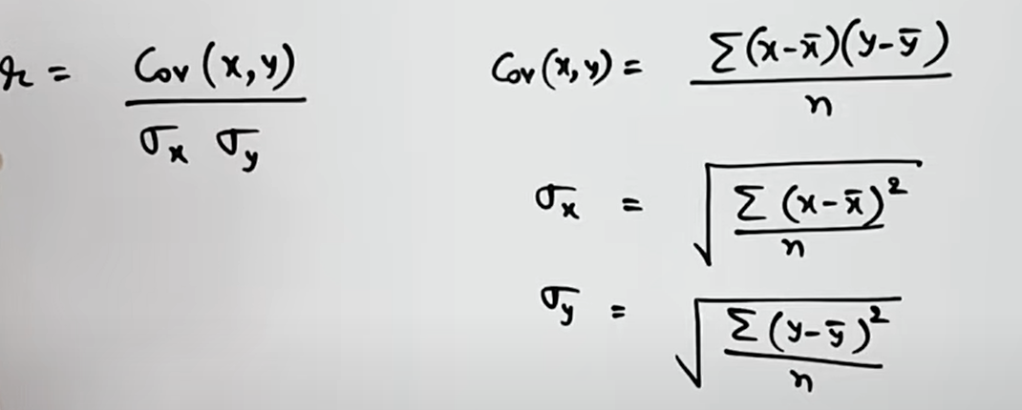
Correlation and Regression Analysis
Method of Finding Correlation coefficient:
Karl Pearson’s Product Moment Method

Slide 9
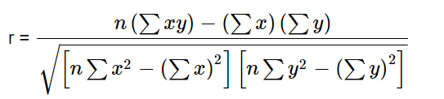
Correlation and Regression Analysis
Method of Finding Correlation coefficient:
Karl Pearson’s Product Moment Method

Slide 10
Correlation and Regression Analysis
Problem: Calculate the correlation coefficient between the following sets of data:
X {9,8,7,6,5,4,3,2,1}
Y {15,16,14,13,11,12,10,8,9}
Solution

Slide 11


Correlation and Regression Analysis
X | Y | X² | Y² | XY
9 | 15 | 81 | 225 | 135
8 | 16 | 64 | 256 | 128
7 | 14 | 49 | 196 | 98
6 | 13 | 36 | 169 | 78
5 | 11 | 25 | 121 | 55
4 | 12 | 16 | 144 | 48
3 | 10 | 9 | 100 | 30
2 | 8 | 4 | 64 | 16
1 | 9 | 1 | 81 | 9
n = no. of pair of observation = 9
∑ XY= 597
∑ X = 45
∑ Y= 108
∑ X² = 285
∑Y² = 1356
r =
r = 0.95

Slide 12
Correlation and Regression Analysis
Significance of Single Correlation Coefficient:
A single correlation coefficient indicates the strength and direction of the relationship between two variables.
Significance testing determines if the correlation coefficient is significantly different from zero, implying that the relationship observed is not due to chance.

Slide 13
Correlation and Regression Analysis
Problem: Calculate the linear correlation coefficient for the following data.
X = 4,8,12,16 and Y = 5, 10, 15, 20.
Solution

Slide 14
Correlation and Regression Analysis
Problem: Calculate the correlation coefficient between the following sets of data:
X {9,8,7,6,5,4,3,2,1}
Y {15,16,14,13,11,12,10,8,9}
Solution

Slide 15
Correlation and Regression Analysis
Significance of Multiple Correlation Coefficients:
Involves multiple independent variables and one dependent variable.
It assesses the combined predictive power of multiple independent variables on the dependent variable.
Significance testing determines whether the set of independent variables as a whole significantly predicts the dependent variable.
Concepts of Multiple Correlation and Partial Correlation:
Multiple correlation: Measures the relationship between a dependent variable and multiple independent variables simultaneously.
Partial correlation: Measures the relationship between two variables while controlling for the effect of one or more other variables.
Notes:
Source: https://rsdlearning.redmondschools.org/2020/01/07/coding-a-natural-way-to-bring-about-computational-thinkers/

Slide 16
Correlation and Regression Analysis
Significance of Multiple Correlation Coefficients:
Dependent Variable Weight
Independent Variable Height + Age
Notes:
Source: https://rsdlearning.redmondschools.org/2020/01/07/coding-a-natural-way-to-bring-about-computational-thinkers/

Slide 17
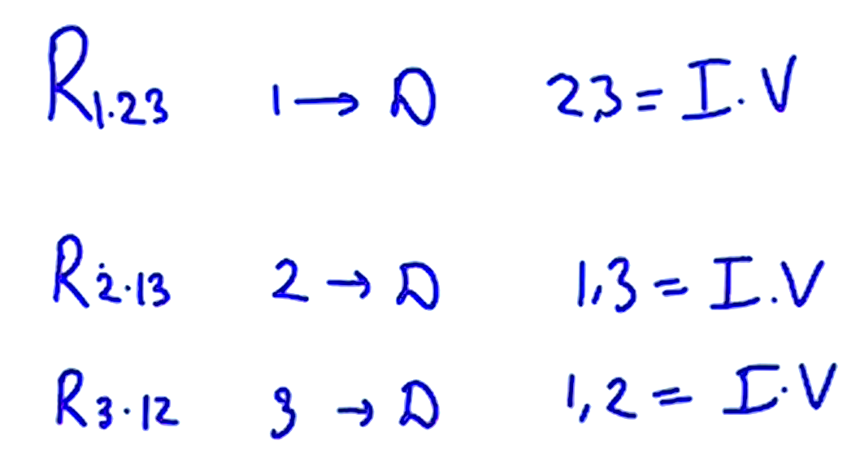
Correlation and Regression Analysis
Significance of Multiple Correlation Coefficients:
Notes:
Source: https://rsdlearning.redmondschools.org/2020/01/07/coding-a-natural-way-to-bring-about-computational-thinkers/

Slide 18
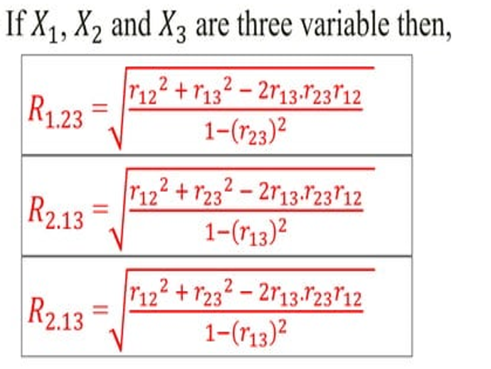
Correlation and Regression Analysis
Significance of Multiple Correlation Coefficients:
Notes:
Source: https://rsdlearning.redmondschools.org/2020/01/07/coding-a-natural-way-to-bring-about-computational-thinkers/

Slide 19
Correlation and Regression Analysis
Problem:
The following zero order correlation coefficients are given:
R₁₂ = 0.98, R₁₃ =0.44 and R₂₃ =0.54
calculate multiple correlation coefficient treating first variable as dependent and second and third variables as independent.
Solution

Slide 20
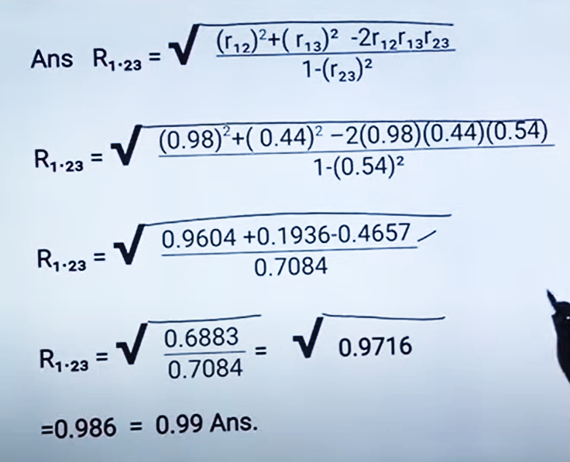
Correlation and Regression Analysis

Slide 21
Correlation and Regression Analysis
Problem: Calculate the correlation coefficient between the following sets of data:
X {9,8,7,6,5,4,3,2,1}
Y {225,86,140,13,11,12,10,8,9}

Slide 22
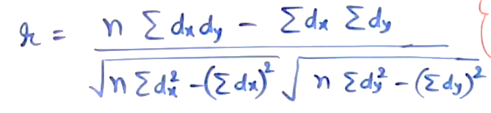
Correlation and Regression Analysis
X-5 Y-11
X | Y | dx | dy | dx² | dy² | dxdy
9 | 15 | 4 | 4 | 16 | 16 | 16
8 | 16 | 3 | 5 | 9 | 25 | 15
7 | 14 | 2 | 3 | 4 | 9 | 6
6 | 13 | 1 | 2 | 1 | 4 | 2
5 | 11 | 0 | 0 | 0 | 0 | 0
4 | 12 | -1 | 1 | 1 | 1 | 1
3 | 10 | -2 | -1 | 4 | 1 | 2
2 | 8 | -3 | -3 | 9 | 9 | 9
1 | 9 | -4 | -2 | 16 | 4 | 8
 | Total | 0 | 9 | 60 | 69 | 57
Shortcut Method
dx = Deviated of X {x-a }{ x-a/h}
dy = Deviated of Y {y-b}{y-b/h}
N, ∑dx, ∑dy, ∑dx², ∑dy², ∑dxdy

Slide 23
Correlation and Regression Analysis
r = 9(57) – 0(9) .
√ 9(60) –(0)² √9(69)-(9)²
r = 513
√540 √540
r = 513\540 = 0.95

Slide 24
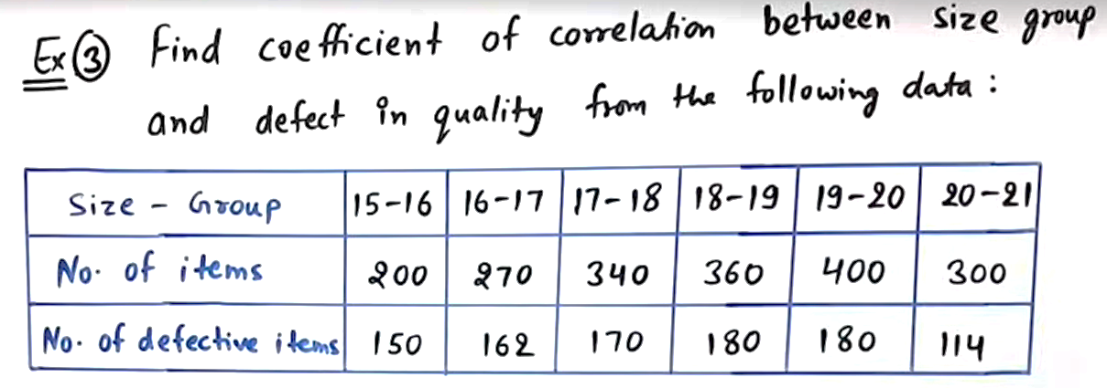
Correlation and Regression Analysis
Problem: find the coefficient correlation of the following of the data
X {9,8,7,6,5,4,3,2,1}
Y {15,16,14,13,11,12,10,8,9}
Solution

Slide 25
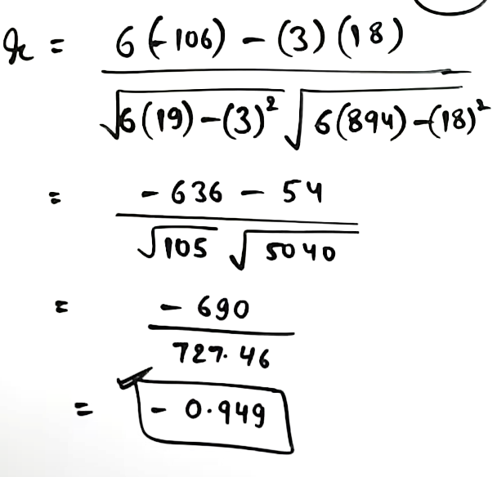
Correlation and Regression Analysis
X-17.5 y-50
N, ∑dx, ∑dy, ∑dx², ∑dy², ∑dxdy
x | Y | X(mid) | Dx | Dy | Dx² | Dy² | dxdy
15-16 | 75 | 15.5 | -2 | 25 | 4 | 625 | -50
16-17 | 60 | 16.5 | -1 | 10 | 1 | 100 | -10
17-18 | 50 | 17.5 | 0 | 0 | 0 | 0 | 0
18-19 | 50 | 18.5 | 1 | 0 | 1 | 0 | 0
19-20 | 45 | 19.5 | 2 | -5 | 4 | 25 | -10
20-21 | 38 | 20.5 | 3 | -12 | 9 | 144 | -36
Total |  |  | 3 | 18 | 19 | 894 | -106

Slide 26
Correlation and Regression Analysis
Introduction to Linear Model:
The linear model represents the relationship between a dependent variable and one or more independent variables as a linear function.
It assumes a straight-line relationship between variables.
Problem: Given a simple linear regression model y = 3x + 5, find the predicted value of y when x = 8.
Solution:
Substitute x = 8 into the equation:
y = 3(8) + 5 = 24 + 5 = 29
Therefore, the predicted value of y when x = 8 is 29.

Slide 27
Correlation and Regression Analysis
Linear Module
Concepts of Factor, Effect, Residuals, Dependency, Independence:
Factor: Independent variable(s) in the linear model that affect the dependent variable.
Effect: The change in the dependent variable associated with a one-unit change in the independent variable(s).
Residuals: Differences between observed and predicted values in the linear model.
Dependency: The relationship between variables in a linear model.
Independence: Assumption that the errors or residuals in a linear model are independent of each other.

Slide 28
Correlation and Regression Analysis
Assumptions of Linear Model:
Linearity: Relationship between variables is linear.
Independence: Residuals are independent of each other.
Homoscedasticity: Residuals have constant variance.
Normality: Residuals are normally distributed.
No multicollinearity: Independent variables are not highly correlated.

Slide 29
Correlation and Regression Analysis
Difference Between Linear and Nonlinear Model:
Linear model assumes a linear relationship between variables, while nonlinear model allows for curved relationships.
Linear models are simpler and more interpretable, whereas nonlinear models can capture more complex relationships but may be harder to interpret.
Estimation of Parameters of Regression Coefficients for Simple and Multiple Linear

Slide 30
Correlation and Regression Analysis
Regression Model:
Simple linear regression: Estimates the slope and intercept of the line that best fits the relationship between two variables.
Multiple linear regression: Estimates the coefficients for each independent variable to best predict the dependent variable.
Notes:
Source: https://www.techtarget.com/whatis/definition/logic-gate-AND-OR-XOR-NOT-NAND-NOR-and-XNOR

Slide 31
Correlation and Regression Analysis
Regression Model:
Regression Analysis is the technique for measuring or estimating the relationship among variables
Regression Analysis provides estimates of values of the dependent variable from the values of the independent variable.
The device used to accomplish this estimation procedure is the regression line.
The regression line describes the average relationship existing between x and y
Notes:
Source: https://www.techtarget.com/whatis/definition/logic-gate-AND-OR-XOR-NOT-NAND-NOR-and-XNOR

Slide 32
Correlation and Regression Analysis
Correlation Analysis
Correlation coefficient is a measure of degree of covariability' between x & y.
In correlation analysis we can not say that one variable is the cause & other the effect
In correlation analysis both Rxy & Ryx. Are symmetric (Rxy=Ryx)
There may be nonsense correlation which has no Practical relevance such as increase in income & increase in weight.
Correlation coeff. is independent of change of scale & origin.
Regression Analysis
Objective of regression analysis is to study the 'nature of relationship’ between variables
In regression analysis it is possible to study cause & effect relationship.
In regression analysis bxy & byx are not symmetric. (bxy ≠ byx)
There is nothing like non-sense regression.
Regression coefficients are independent of change of origin but not of scale
Notes:
Source: https://www.techtarget.com/whatis/definition/logic-gate-AND-OR-XOR-NOT-NAND-NOR-and-XNOR

Slide 33
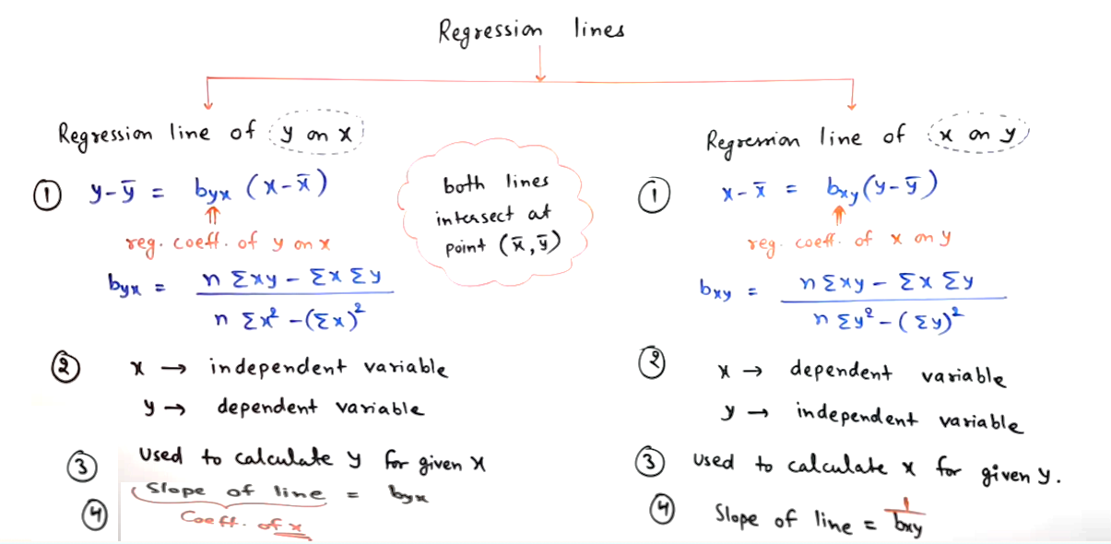
Correlation and Regression Analysis
Notes:
Source: https://www.techtarget.com/whatis/definition/logic-gate-AND-OR-XOR-NOT-NAND-NOR-and-XNOR

Slide 34
Correlation and Regression Analysis
Properties of Regression Coefficients:
Regression coefficients represent the change in the dependent variable for a one-unit change in the independent variable, holding other variables constant.
They indicate the strength and direction of the relationship between variables.
Significance of Regression Coefficients:
Significance testing determines whether the regression coefficients are significantly different from zero, indicating whether the independent variables have a significant effect on the dependent variable.
Notes:
Source:Computational thinking - A beginner's guide to problem solving & programming Karl Beecher

Slide 35
Correlation and Regression Analysis
Diagnostic Testing: Autocorrelation, Multicollinearity, Heteroscedasticity, Normality:
Autocorrelation: Presence of correlation between the residuals of a time series model.
Multicollinearity: High correlation between independent variables in a regression model, which can affect the stability and interpretation of coefficients.
Heteroscedasticity: Unequal variance of residuals across levels of the independent variables.
Normality: Residuals should be normally distributed for valid inference from the model.
Notes:
Source: https://www.techtarget.com/whatis/definition/logic-gate-AND-OR-XOR-NOT-NAND-NOR-and-XNOR

Slide 36
Correlation and Regression Analysis
Significance of Estimated Parameters in Multiple Linear Regression:
Determines the importance of each independent variable in predicting the dependent variable.
Significant parameters indicate variables that significantly contribute to explaining the variation in the dependent variable.

Slide 37
Correlation and Regression Analysis
Problem :
Find both regression lines (x on y & y on x) for the following data:
X { 6,2,10,4,8}
Y {9,11,5,8,7}

Slide 38



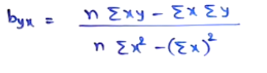

Correlation and Regression Analysis
X on Y =
Y on X =
N, ∑xy, ∑x, ∑y, ∑x², ∑y²
x | y | X² | Y² | Xy
6 | 9 | 36 | 81 | 54
2 | 11 | 4 | 121 | 22
10 | 5 | 10 | 25 | 50
4 | 8 | 16 | 64 | 32
8 | 7 | 64 | 49 | 56
30 | 40 | 220 | 340 | 214

Slide 39
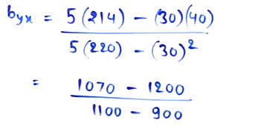
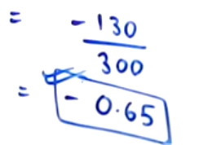
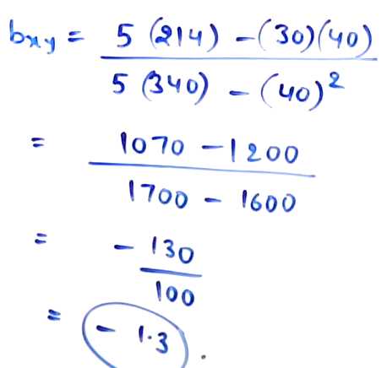
X on y = X-6 = -(1.3) (Y-8)
X-6 = -(1.3)Y +(1.3)8
X= -(1.3)Y +10.4 +6
X= -(1.3)Y +16.4
Y on x = Y-8 = -0.65 (X-6)
Y-8 = -(0.65)X + (0.65)(6)
Y = -(0.65)X+ 4.9

Slide 40
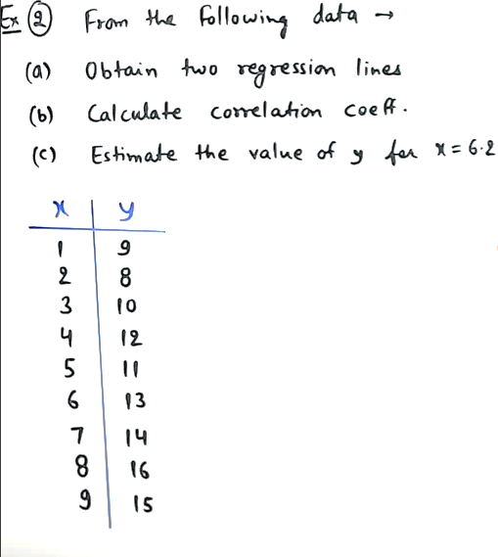

Slide 41
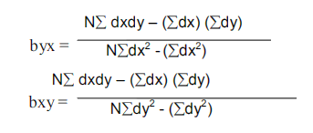
Correlation and Regression Analysis
X on Y =
Y on X =
X-5 y-12
X | Y | dX | dY | dX² | dY² | dxdy
1 | 9 | -4 | -3 | 16 | 9 | 12
2 | 8 | -3 | -4 | 9 | 16 | 12
3 | 10 | -2 | -2 | 4 | 4 | 4
4 | 12 | -1 | 0 | 1 | 0 | 0
5 | 11 | 0 | -1 | 0 | 1 | 0
6 | 13 | 1 | 1 | 1 | 1 | 1
7 | 14 | 2 | 2 | 4 | 4 | 4
8 | 16 | 3 | 3 | 9 | 16 | 9
9 | 15 | 4 | 3 | 16 | 9 | 16
45 | 108 | 0 | 0 | 60 | 60 | 57

Slide 42
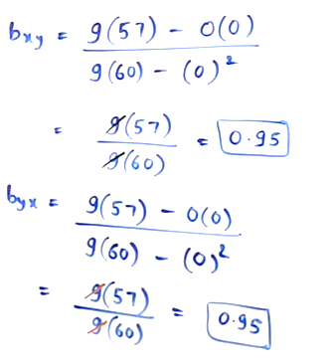
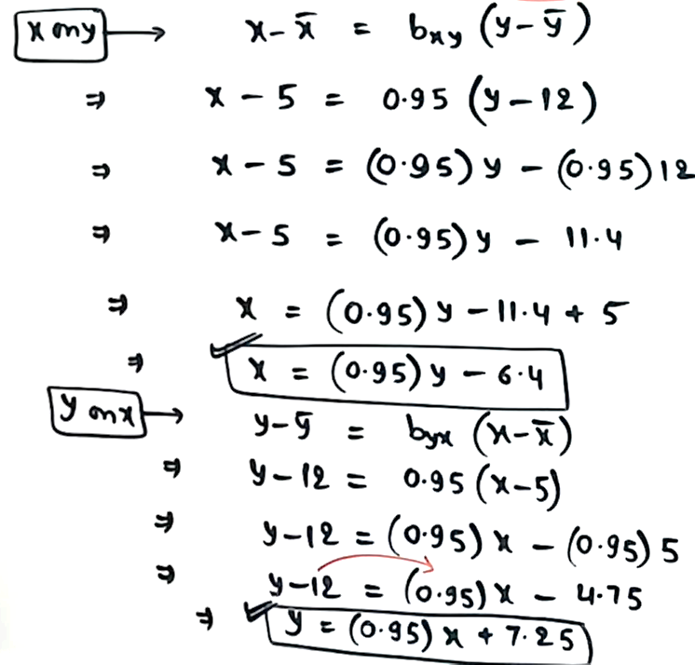

Slide 43
B) r= √bxy * byx
√0.95*0.95
r = 0.95
Y = (0.95)6.2 +7.2
y = 5.89+7.25
y = 13.14

